Slide 1
Building a Smarter AI-Powered Spam Classifier
TEAM MEMBERS
G. GANESH GOPAL (821021104019)
S. ABDUR RAZZAK (821021104004)
K. SRI RAM (821021104044)
B. GANESH (821021104302)
K. SIVA PRAKASH (821021104305)

Slide 2
PHASE 4 DEVELOPMENT PART 2
TASK
DATASET LINK
Building Project Spam Classifier By Selecting A Machine Learning Algorithm, Training The Model , Evaluating Its Performance
https://www.kaggle.com/datasets/uciml/sms-spam-collection-dataset

Slide 3

OBJECT DETECTION WITH
Object detection is a popular task in computer vision.
YOLO (You Only Look Once) is a popular object detection model known for its speed and accuracy. It was first introduced by Joseph Redmon et al. in 2016 and has since undergone several iterations, the latest being YOLO v7.
YOLO divides an input image into an S × S grid. If the center of an object falls into a grid cell, that grid cell is responsible for detecting that object. Each grid cell predicts B bounding boxes and confidence scores for those boxes.

Slide 4
RECURRENT NEURAL NETWORKS
Recurrent Neural Network(RNN) is a type of Neural Network where the output from the previous step is fed as input to the current step.
The main and most important feature of RNN is its Hidden state, which remembers some information about a sequence. The state is also referred to as Memory State since it remembers the previous input to the network.

Slide 5
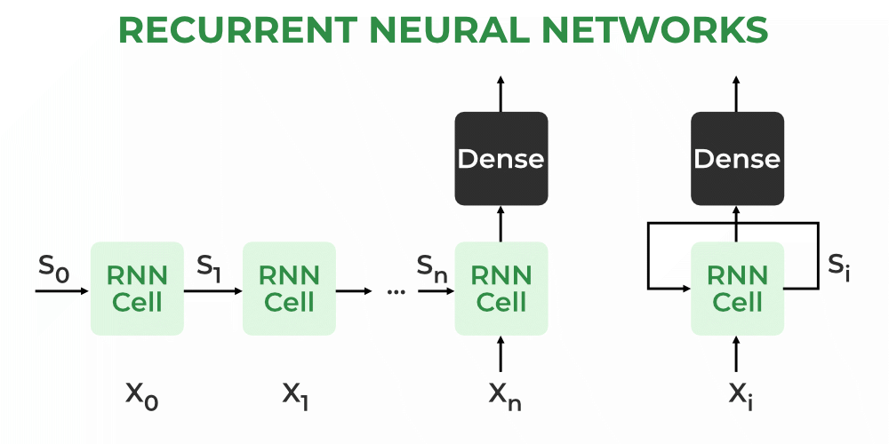
Advantages of Recurrent Neural Network
An RNN remembers each and every piece of information through time. It is useful in time series prediction only because of the feature to remember previous inputs as well. This is called Long Short Term Memory.
Disadvantages of Recurrent Neural Network
Gradient vanishing and exploding problems.
Training an RNN is a very difficult task.

Slide 6
Applications of Recurrent Neural Network 1.Language Modelling and Generating Text 2.Speech Recognition 3.Machine Translation 4.Image Recognition, Face detection 5.Time series Forecasting TYPES OF RNN : 1.One to One 2.One to Many 3.Many to One 4. Many to Many

Slide 7
Natural language processing
Natural language processing (NLP) is a machine learning technology that gives computers the ability to interpret, manipulate, and comprehend human language. Organizations today have large volumes of voice and text data from various communication channels like emails, text messages, social media newsfeeds, video, audio, and more.
Why Nlp Is Important ?
Natural language processing (NLP) is critical to fully and efficiently analyze text and speech data. It can work through the differences in dialects, slang, and grammatical irregularities typical in day-to-day conversations.

Slide 8
How does NLP work?
Natural language processing (NLP) combines computational linguistics, machine learning, and deep learning models to process human language.
Computational linguistics
Machine learning
Deep learning
NLP implementation steps
Pre-processing
Training
Deployment and inference

Slide 9
What are NLP tasks?
Natural language processing (NLP) techniques, or NLP tasks, break down human text or speech into smaller parts that computer programs can easily understand. Common text processing and analyzing capabilities in NLP are given below.
Part-f-speech tagging
Word-sense disambiguation
Speech recognition
Machine translation
Named-entity recognition
Sentiment analysis
Approaches to NLP?
Supervised NLP
Unsupervised NLP
Natural language understanding
Natural language generation

Slide 10
Data Collection and Preprocessing: 1. Download the dataset from the provided Kaggle link. 2. Load the dataset and examine its structure. 3. Preprocess the text data by removing punctuation, converting text to lowercase, and tokenizing the messages. Data Exploration: Explore the dataset to understand its distribution, class balance, and any patterns in the data. Feature Extraction: Convert the text messages into numerical features. You can use TF-IDF (Term Frequency-Inverse Document Frequency) or other techniques like Word Embeddings (Word2Vec, GloVe).

Slide 11
Split Data: Split the dataset into a training set, a validation set, and a test set. A common split is 70% for training, 15% for validation, and 15% for testing. Select a Machine Learning Algorithm: Choose a machine learning algorithm for text classification. For this task, a good starting point is to use Multinomial Naive Bayes, which is a common choice for text classification problems. Model Training: Train the selected algorithm on the training data using the features you've extracted.

Slide 12
program
In [1]:
In [2]:
In [3]:
Out [3]:
Importing Libraries
import pandas as pd
import numpy as np
from sklearn.model_selection import train_test_split
from sklearn.feature_extraction.text import TfidfVectorizer
from sklearn.linear_model import LogisticRegression
from sklearn.metrics import accuracy_score, confusion_matrix, roc_curve, roc_auc_score
import nltk
from nltk.corpus import stopwords
from collections import Counter
Libraries for visualisation
import matplotlib.pyplot as plt
import seaborn as sns
Download the stopwords dataset
nltk.download('stopwords')
True

Slide 13
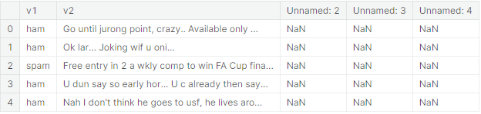
In [4]:
In [5]:
Out [5]:
In [6]:
Reading and Describing Data
# Loading the dataset
df = pd.read_csv("/kaggle/input/sms-spam-collection-dataset/spam.csv",encoding='latin-1')
# Displaying the first few rows of the dataset
df.head()
# Droping unnecessary columns from the DataFrame
columns_to_drop = ["Unnamed: 2", "Unnamed: 3", "Unnamed: 4"]
df.drop(columns=columns_to_drop, inplace=True)

Slide 14
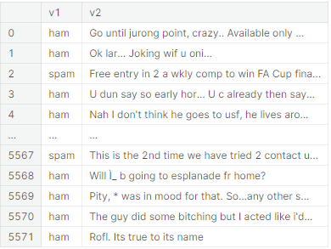
# Displaying the data
df
5572 rows × 2 columns
# Consice information of the dataset
df.info()
In [7]:
Out [7]:
In [8]:

Slide 15
Out [8]:
In [9]:
Out [9]:
In [10]:
Out [10]:
<class 'pandas.core.frame.DataFrame'>
RangeIndex: 5572 entries, 0 to 5571
Data columns (total 2 columns):
# Column Non-Null Count Dtype
--- ------ -------------- -----
0 v1 5572 non-null object
1 v2 5572 non-null object
dtypes: object(2)
memory usage: 87.2+ KB
df.shape
(5572, 2)
df.describe()
v1 v2
count 5572 5572
unique 2 5169
top ham Sorry, I'll call later
freq 4825 30

Slide 16
In [11]:
Out [11]:
In [12]:
Out [12]:
In [13]:
In [14]:
Out [14]:
df.isnull().sum()
v1 0
v2 0
dtype: int64
df.columns
Index(['v1', 'v2'], dtype='object')
# Rename the columns "v1 and "v2" to new names
new_column_names = {"v1":"Category","v2":"Message"}
df.rename(columns = new_column_names,inplace = True)
df.head()
Category Message
0 ham Go until jurong point, crazy.. Available only ...
1 ham Ok lar... Joking wif u oni...
2 spam Free entry in 2 a wkly comp to win FA Cup fina...
3 ham U dun say so early hor... U c already then say...
4 ham Nah I don't think he goes to usf, he lives aro...

Slide 17
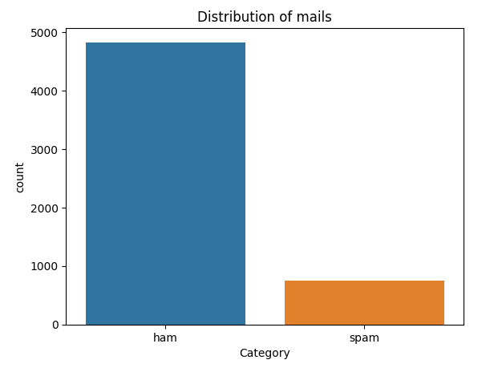
In [15]:
Out [15]:
Data Visualisation
sns.countplot(data=df, x='Category')
plt.xlabel('Category')
plt.ylabel('count')
plt.title('Distribution of mails')
plt.show()

Slide 18
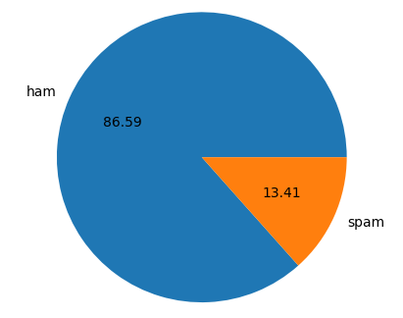
In [16]:
plt.pie(df['Category'].value_counts(),labels=['ham','spam'],autopct='%0.2f')
plt.show()

Slide 19
In [17]:
In [18]:
In [19]:
Out [19]:
Data Preprocessing
Label Encoding
df.loc[df["Category"] == "spam", "Category"] = 0
df.loc[df["Category"] == "ham", "Category"] = 1
# Separate the feature (message) and target (category) data
X = df["Message"]
Y = df["Category"]
print(X)
0 Go until jurong point, crazy.. Available only ...
1 Ok lar... Joking wif u oni...
2 Free entry in 2 a wkly comp to win FA Cup fina...
3 U dun say so early hor... U c already then say...
: : : : :
5568 Will Ì_ b going to esplanade fr home?
5569 Pity, * was in mood for that. So...any other s...
5570 The guy did some bitching but I acted like i'd...
5571 Rofl. Its true to its name
Name: Message, Length: 5572, dtype: object

Slide 20
In [20]:
Out [20]:
In [21]:
In [22]:
Out [22]:
print(Y)
0 1
1 1
2 0
3 1
4 1
5567 0
5568 1
5569 1
5570 1
5571 1
Name: Category, Length: 5572, dtype: object
Splitting the data into training data and test data
X_train, X_test, Y_train, Y_test = train_test_split(X, Y, test_size = 0.2, random_state = 3)
# Print the shape of X
print(X.shape)
(5572,)

Slide 21
In [23]:
Out [23]:
In [24]:
In [25]:
In [26]:
In [27]:
# Print the shape of X_train and X_test
print(X_train.shape)
print(X_test.shape)
(4457,)
(1115,)
Feature Extraction
TF-IDF Vectorizer
# Initialize TF-IDF Vectorizer
feature_extraction = TfidfVectorizer(min_df=1, stop_words="english", lowercase=True)
# Feature extraction for training and testing data
X_train_features = feature_extraction.fit_transform(X_train)
X_test_features = feature_extraction.transform(X_test)
# Convert Y_train and Y_test to integer type
Y_train = Y_train.astype("int")
Y_test = Y_test.astype("int")
print(X_train)

Slide 22
Out [27]:
In [28]:
Out [28]:
3075 Mum, hope you are having a great day. Hoping t...
1787 Yes:)sura in sun tv.:)lol.
1614 Me sef dey laugh you. Meanwhile how's my darli...
4304 Yo come over carlos will be here soon
3266 Ok then i come n pick u at engin?
...
789 Gud mrng dear hav a nice day
968 Are you willing to go for aptitude class.
1667 So now my dad is gonna call after he gets out ...
3321 Ok darlin i supose it was ok i just worry too ...
1688 Nan sonathaya soladha. Why boss?
Name: Message, Length: 4457, dtype: object
print(X_train_features)
(0, 741) 0.3219352588930141
(0, 3979) 0.2410582143632299
(0, 4296) 0.3891385935794867
: : : : :
(4456, 6133) 0.5304350313291551
(4456, 1386) 0.4460036316446079
(4456, 4557) 0.48821933148688146

Slide 23
In [29]:
Out [29]:
In [30]:
In [31]:
Out [31]:
Model Selection and Training
Logistic Regresion
# Creating and Fit Logistic Regression Model
model = LogisticRegression()
model.fit(X_train_features, Y_train)
> LogisticRegression
LogisticRegression()
Evaluating the trained model
#Make predictions on the training data
predict_train_data=model.predict(X_train_features)
#Model Evaluation
from sklearn.metrics import accuracy_score,confusion_matrix
accuracy_train_data=accuracy_score(Y_train,predict_train_data)
print("Accuracy on training data: ",accuracy_train_data)
Accuracy on training data: 0.9661207089970832

Slide 24
In [32]:
In [33]:
Out [33]:
In [34]:
Out [34]:
# Make predictions on the testing data
predict_test_data=model.predict(X_test_features)
#Model Evaluation
accuracy_test_data=accuracy_score(Y_test,predict_test_data)
print("acuuracy on test data: ",accuracy_test_data)
acuuracy on test data: 0.9623318385650225
Test the model with an email messages
new_mail=["Congratulations on your recent achievement! Well done."]
new_data_features=feature_extraction.transform(new_mail)
prediction=model.predict(new_data_features)
print(prediction)
if(prediction[0]==1):
print("Ham Mail")
else:
print("Spam Mail")
[1]
Ham Mail

Slide 25
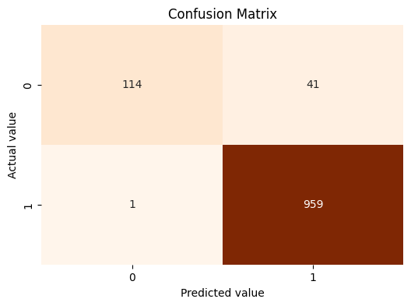
In [35]:
Out [35]:
Confusion Matrix
conf_matrix=confusion_matrix(Y_test,predict_test_data)
plt.figure(figsize=(6,4))
sns.heatmap(conf_matrix,annot=True,fmt="d",cmap="Oranges",cbar=False)
plt.xlabel("Predicted value")
plt.ylabel("Actual value")
plt.title("Confusion Matrix")
plt.show()

Slide 26
In [36]:
# Data visualization - Top 7 Most Common Words in Spam Emails
stop_words = set(stopwords.words('english'))
spam_words = " ".join(df[df['Category'] == 0]['Message']).split()
ham_words = " ".join(df[df['Category'] == 1]['Message']).split()
spam_word_freq = Counter([word.lower() for word in spam_words if word.lower() not in stop_words and word.isalpha()])
plt.figure(figsize=(10, 6))
plt.bar(*zip(*spam_word_freq.most_common(7)), color='y')
plt.xlabel('Words')
plt.ylabel('Frequency')
plt.title('Top 7 Most Common Words in Spam Emails')
plt.xticks(rotation=45)
plt.show()

Slide 27
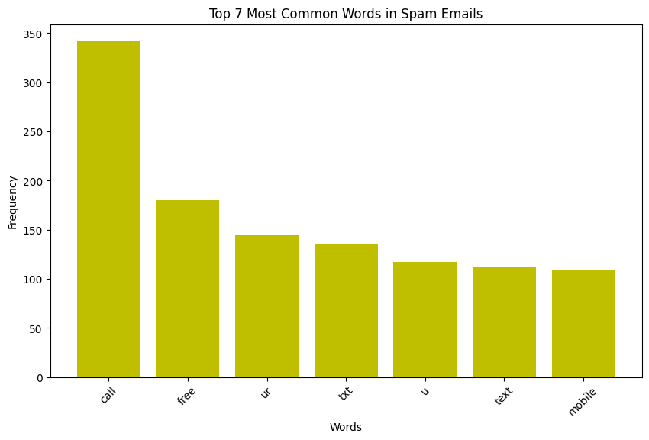
Out [36]:

Slide 28
Conclusion:
The Development And Implementation Of A Spam Classifier Is A Crucial Step In Enhancing The Efficiency And Security Of Digital Communication. This Project Has Demonstrated The Effectiveness Of Machine Learning Algorithms In Distinguishing Between Legitimate Messages And Unsolicited Spam, Thereby Reducing The Risk Of Falling Victim To Phishing Scams, Malware, And Unwanted Advertisements.
The Classifier, Trained On A Diverse Dataset And Fine-tuned Through Iterative Testing And Optimization, Has Showcased Commendable Accuracy And Reliability. It Has Proven Capable Of Adapting To Evolving Spamming Techniques And Maintaining A Low False-positive Rate, Ensuring That Important Messages Are Not Inadvertently Labeled As Spam.

Slide 29
Thank you

